Slide 1
Agile Development
Dr. Susmita mandal

Slide 2
What is Agility
According to Jacobson agility means the ability to change quickly. Change is what software development is very much about. Changes in-
software being built
changes to the team members
changes because of new technology
changes of all kinds that may have an impact on the product they build or the project that creates the product.
Agility is more than an effective response to change. It encourages team members to make communication effortless among technologists and business people, between software engineers and their managers.
It adopts the customer as a part of the development team and lets planning to be flexible.

Slide 3
Agility and the cost of change
Cost of change using conventional software processes:
The cost of change increases nonlinearly as a project progresses. However, It is relatively easy to accommodate a change when a software team is gathering requirements (early in a project). But if in the middle of validation testing, a stakeholder is requesting a major functional change. Then the change requires a modification to the architectural design, construction of new components, changes to other existing components, new testing and so on. Costs escalate quickly.
Cost of change using agile processes:
A well-designed agile process may “flatten” the cost of change curve by coupling incremental delivery with agile practices such as continuous unit testing and pair programming. Thus team can accommodate changes late in the software project without dramatic cost and time impact.
An agile process reduces the cost of change because software is released in increments and change can be better controlled within an increment.

Slide 4
Change costs as a function of time in development

Slide 5
What is an agile process?
Any Agile software process is characterized using following key assumptions-
It is difficult to predict in advance which software requirements will persist and which will change. It is equally difficult to predict how customer priorities will change as the project proceeds.
It is difficult to predict how much design is necessary before construction is used to prove the design. As in many types of software, design and construction are interleaved.
Analysis, design, construction, and testing are not as predictable.
Given these three assumptions, an important question arises: How do we create a process that can manage unpredictability?
Answer: An agile process, therefore, must be adaptable. It must adapt incrementally for which an agile team requires customer feedback. An advantage of such feedback is operational prototype.
In the Agile Methodology, software is developed in incremental, rapid cycles. This model is combination of iterative and incremental process models with focus on process adaptability and customer satisfaction by rapid delivery of working software product.

Slide 6
Agility principles-I
1. Our highest priority is to satisfy the customer through early and continuous delivery of valuable software.
2. Welcome changing requirements, even late in development. Agile processes harness change for the customer’s competitive advantage.
3. Deliver working software frequently, from a couple of weeks to a couple of months, with a preference to the shorter timescale.
4. Business people and developers must work together daily throughout the project.
5. Build projects around motivated individuals. Give them the environment and support they need, and trust them to get the job done.
6. The most efficient and effective method of conveying information to and within a development team is face-to-face conversation.

Slide 7
Agility principles-II
7. Working software is the primary measure of progress.
8. Agile processes promote sustainable development. The sponsors, developers, and users should be able to maintain a constant pace indefinitely
9. Continuous attention to technical excellence and good design enhances agility.
10. Simplicity—the art of maximizing the amount of work not done—is essential.
11. The best architectures, requirements, and designs emerge from self–organizing teams.
12. At regular intervals, the team reflects on how to become more effective, then tunes and adjusts its behavior accordingly.

Slide 8
Human Factors
Agile development focuses on the talents and skills of individuals, molding the process to specific people and teams. The key point in this statement is that the process molds to the needs of the people and team, not the other way around.
key traits must exist among the people on an agile team and the team itself:
Competence: talent, software related skills, overall knowledge of the process
Common focus: to deliver a working software increment to the customer within the time promised
Collaboration: team members must collaborate to assess, analyze and communicate while creating and building information that will help all stakeholders understand the work of the team.
Decision-making ability: Freedom to take decision for both technical and project related issues.
Fuzzy problem-solving ability: ambiguity and constant changes, today problem may not be tomorrow’s problem
Mutual trust and respect: an important aspect is to trust and respect the members and project
Self-organization: It implies three things- organize work, process for its local environment, the work schedule

Slide 9
Extreme Programming (XP)
Extreme Programming (XP) is an agile software development framework that aims to produce higher quality software, and higher quality of life for the development team. The most widely used agile process, originally proposed by Kent Beck in 2004. It uses an object-oriented approach.
XP Values:
Kent Beck defines a set of five values- communication, simplicity, feedback, courage, and respect.
Communication: XP emphasizes close, yet informal (verbal) collaboration between customers and developers.
Simplicity: XP restricts developers to design only for immediate needs, rather than consider future needs
Feedback: It is derived from three sources: the implemented software itself, the customer, and other software team members. By designing and implementing an effective testing strategy the software provides the agile team with feedback. XP makes use of the unit test as its primary testing tactic.
Courage: XP practices strict discipline. An agile XP team must have the discipline (courage) to design for today, recognizing that future requirements may change dramatically, thereby demanding substantial rework of the design and implemented code.
Respect: Respect among it members, between other stakeholders and team members for the software itself

Slide 10
In extreme programming, requirements are expressed as scenarios (called user stories), which are implemented directly as a series of tasks.
Programmers work in pairs and develop tests for each task before writing the code. All tests must be successfully executed when new code is integrated into the system.
There is a short time gap between releases of the system. The figure below shows a XP process to produce an increment of the system that is being developed.
The extreme programming release cycle

Slide 11
Principles-I
Extreme programming involves a number of practices which reflect the principles of agile methods:

Slide 12
Principles-II

Slide 13
XP Process
Planning: The planning activity (also called the planning game) begins with listening—a requirements gathering activity.
It enables the technical members of the XP team to understand the business context for the software and to get a broad feel for required output and major features and functionality.
Listening leads to the creation of a set of “stories” (also called user stories). A user story is a scenario of use that might be experienced by a system user.
The customer and the development team and discusses scenarios with other team members and develops a story card that encapsulates the customer needs.

Slide 14
An example of a story card for the mental health care patient management system.

Slide 15
The story cards are the main inputs to the XP planning process or the ‘planning game’.
Once the story cards have been developed, the development team breaks these down into tasks and estimates the effort and resources required for implementing each task.
Examples of task cards for
prescribing medication.

Slide 16
XP team orders the stories that will be developed in one of three ways:
(1) all stories will be implemented immediately (within a few weeks),
(2) the stories with highest value will be moved up in the schedule and implemented first, or
(3) the riskiest stories will be moved up in the schedule and implemented first.
After the first project release (or s/w increment) the XP team computes project velocity-
It is the number of customer stories implemented during the first release. It is used to
(1) help estimate delivery dates and schedule for subsequent releases
(2) determine whether an over commitment has been made for all stories across the entire development project.

Slide 17
Design
XP design rigorously follows the KIS (keep it simple) principle. A simple design is always preferred over a more complex representation.
XP encourages the use of class-responsibility collaborator (CRC) cards that identifies and organizes the object-oriented classes, relevant to the current software increment.
If a difficult design problem is encountered as part of the design of a story, XP recommends the immediate creation of an operational prototype of that portion of the design. Called a spike solution, the design prototype is implemented and evaluated to lower the risk during main implementation.
XP encourages refactoring- which is a method of design optimization.
Refactoring is the process of changing a software system in such a way that it does not alter the external behavior of the code yet improves the internal structure.
Example: Reorganization of a class hierarchy to remove duplicate code, the tidying up and renaming of attributes and methods, and the replacement of similar code sections, etc

Slide 18
Coding
Pair programming is a key concept during coding activity. XP recommends that two people work together at one computer workstation to create code for a story.
The use of pair programming has a number of advantages:
It supports the idea of collective ownership and responsibility for the system.
It acts as an informal review process because each line of code is looked at by at least two people. Code inspections and reviews are very successful in discovering a high percentage of software errors. However, they are time consuming.
It helps support refactoring, which is a process of software improvement.
Scenario: Many companies that have adopted agile methods are thinking pair programming is inefficient. Whereas many companies mix pair and individual programming with an experienced programmer working with less experienced colleague when they have problem.

Slide 19
Testing
XP emphasizes the importance of program testing which includes the key features-
1. test-first development:
It requires a clear relationship between system requirements and the code implementing the corresponding requirements. This relationship is clear because the story cards representing the requirements are broken down into tasks and the tasks are the principal unit of implementation.
Instead of writing some code and then writing tests for that code, you write the tests before you write the code. This means that you can run the test as the code is being written and discover problems during development.
2. incremental test development from scenarios,
3. user involvement in the test development and validation, and
4. the use of automated testing frameworks.
Test case description for dose checking

Slide 20
Adaptive Software Development (ASD)
In the year 2000, Jim Highsmith proposed ASD as a a technique to build complex software and system.
ASD focuses on human collaboration and team self-organization. The lifecycle of ASD incorporates three phases, speculation, collaboration, and learning.
1. Speculation: project is initiated and adaptive cycle planning is conducted. Adaptive cycle planning uses project initiation information- the customer’s mission statement, project constraints (e.g. delivery date), and basic requirements to define the set of release cycles (increments) that will be required for the project. Based on the information obtained at the completion of the first cycle, the plan is reviewed and adjusted so that planned work better fits the reality.
2. Collaborations: are used to multiply their talent and creative output beyond absolute number. It encompasses communication and teamwork, but it also emphasizes individualism, because individual creativity plays an important role in collaborative thinking.

Slide 21
It is a matter of trust.
1) criticize without animosity,
2) assist without resentments,
3) work as hard as or harder than they do.
4) have the skill set to contribute to the work at hand,
5) communicate problems or concerns in a way that leas to effective action.
3. Learning: As members of ASD team begin to develop the components, the emphasis is on “learning”. Highsmith argues that software developers often overestimate their own understanding of the technology, the process, and the project and that learning will help them to improve their level of real understanding. Three ways: focus groups, technical reviews and project postmortems.
Adaptive software development

Slide 22
Scrum
A software development method Originally proposed by Schwaber and Beedle (an activity occurs during a rugby match) in early 1990.
It focuses on providing a framework for agile project organization, and it need not to use development practices such as pair programming and test-first development. This means it can be more easily integrated with existing practice in a company.
In general way instead of providing complete, detailed descriptions of how everything is to be done on a project, much of it is left up to the Scrum software development team. This is because the team will know best how to solve the problem they are presented.
Scrum incorporates following framework activities: requirements, analysis, design, evolution, and delivery. Within each framework activity, work tasks occur within a process pattern called a sprint.
The input to the process is the product backlog. Each process iteration produces a product increment that could be delivered to customers.

Slide 24
Development actions are defined with process pattern:
Backlog: a prioritized list of project requirements or features that provide business value for the customer. The product manager assesses the backlog and updates priorities as required.
Sprints: consist of work units that are required to achieve a requirement defined in the backlog that must be fit into a predefined time-box where a time-box is a project management term that indicates a period of time that has been allocated to accomplish some task.
Scrum meetings: are short (typically 15 minutes) meetings held daily by the Scrum team. Three key questions are asked and answered by all team members:
• What did you do since the last team meeting?
• What obstacles are you encountering?
• What do you plan to accomplish by the next team meeting?
A team leader, called a Scrum master, leads the meeting and assesses the responses from each person.
Demos: are delivered to the customer with the time-box allocated. May not contain all functionalities. So customers can evaluate and give feedbacks.

Slide 25
Dynamic Systems Development Method (DSDM)
DSDM is an agile software development approach that “provides a framework for building and maintaining systems which meet tight time constraints through the use of incremental prototyping in a controlled project environment.
The DSDM philosophy is borrowed from a modified version of the Pareto principle—80 percent of an application can be delivered in 20 percent of the time it would take to deliver the complete (100 percent) application.
Promoted by the DSDM Consortium (www.dsdm.org) is a worldwide group of member companies that collectively take on the role of “keeper” of the method.
DSDM Lifecycle:
Feasibility Study: establishes the basic business requirements and constraints associated with the application to be built and then assess whether the application is viable.

Slide 26
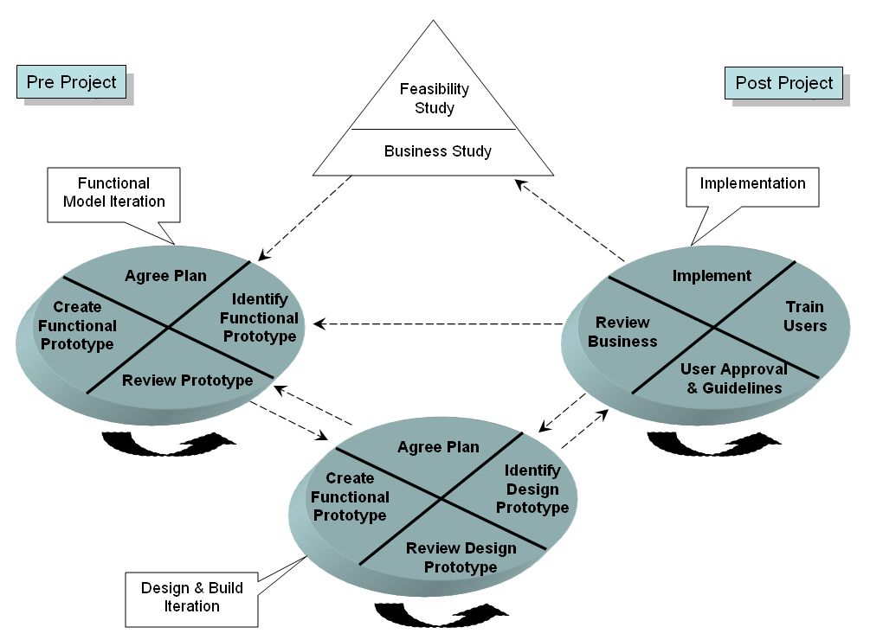
Business Study: establishes the functional and information requirements that
will allow the application to provide business value.
Functional model iteration: produces a set of
incremental prototypes that demonstrate
functionality for the customer.
Design and build iteration—revisits prototypes
built during functional model iteration to
ensure that each has been engineered in
a manner that will enable it to provide
operational business value for end users.
In some cases, functional model iteration
and design and build iteration occur concurrently.
Implementation—places the latest software increment
into the operational environment. It should be noted that
the increment may not be 100 percent complete or
changes may be requested as the increment is put into place.
In either case, DSDM development work continues by returning to the functional model iteration activity.

Slide 27
Feature Driven Development (FDD)
Originally proposed by Peter Coad et al. as a object-oriented software engineering process model.
FDD—distinguishing features
• Because features are small blocks of deliverable functionality, users can describe them more easily; understand how they relate to one another more readily; and better review them for ambiguity, error, or omissions.
• Features can be organized into a hierarchical business-related grouping. A feature “is a client-valued function that can be implemented
in two weeks or less.
• Since a feature is the FDD deliverable software increment, the team develops operational features every two weeks.
• Because features are small, their design and code representations are easier to inspect effectively.
• Project planning, scheduling, and tracking are driven by the feature hierarchy, rather than an arbitrarily adopted software engineering task set.

Slide 28
Uses a feature template: <action> the <result> <by | for | of | to> a(n) <object>
where an <object> is “a person, place, or thing (including roles, moments in time or intervals of time, or catalog-entry-like descriptions).” Examples of features for an e-commerce application might be:
Add the product to shopping cart
Display the technical-specifications of the product
Store the shipping-information for the customer
The FDD approach defines five “collaborating” framework activities-

Slide 29
Agile Modeling (AM)
Scott Ambler describes AM as-
Agile Modeling (AM) is a practice-based methodology for effective modeling and documentation
of software-based systems.
Simply put, Agile Modeling (AM) is a collection of values, principles, and practices for modeling software that can be applied on a software development project in an effective and light-weight manner.
Agile models are more effective than traditional models because they are just barely good, they don’t have to be perfect.
Features of AM-
Model with a purpose. A developer who uses AM should have a specific
goal (e.g., to communicate information to the customer or to help better understand
some aspect of the software) before creating a model.

Slide 30
AM features
Use multiple models. There are many different models and notations that can be used to describe software. AM suggests to use only those models that provide value to their intended audience.
Travel light. As software engineering work proceeds, keep only those models that will provide long-term value and drop the rest.
Content is more important than representation. A syntactically perfect model that imparts little useful content is not as valuable as a model with flawed notation that nevertheless provides valuable content for its audience.
Know the models and the tools you use to create them. Understand the strengths and weaknesses of each model and the tools that are used to create it.
Adapt locally. The modeling approach should be adapted to the needs of the agile team.
Note:- A major segment of the software engineering community has adopted the Unified Modeling Language (UML)16 as the preferred method for representing analysis and design models.

